Slide 1
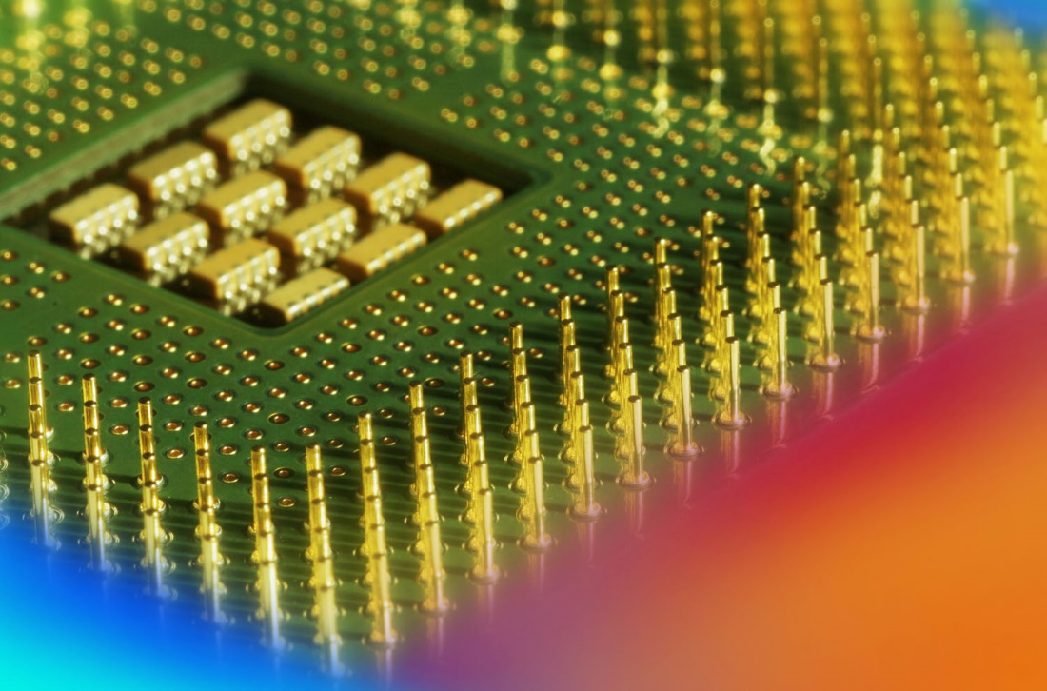
Digital Fundamentals
Tenth Edition
Floyd
Chapter 1
© 2008 Pearson Education

Slide 2
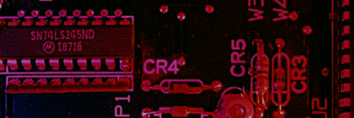
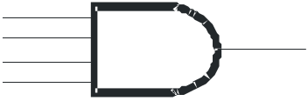
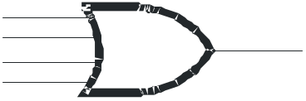
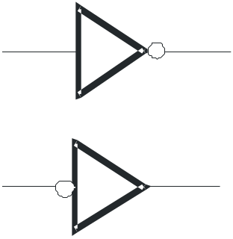
Summary
Basic Logic Functions
AND
True only if all input conditions are true.
OR
True only if one or more input conditions are true.
NOT
Indicates the opposite condition.

Slide 3
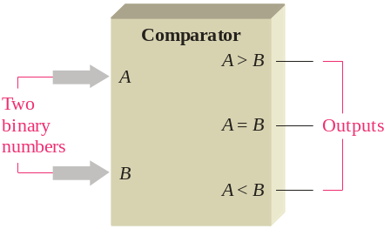
Summary
Basic System Functions
And, or, and not elements can be combined to form various logic functions. A few examples are:
The comparison function

Slide 4
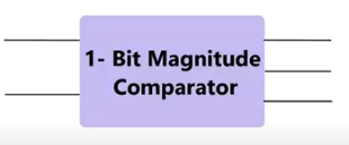
Summary
Basic System Functions
And, or, and not elements can be combined to form various logic functions. A few examples are:
The comparison function
A
A>B
B
A=B
A<B

Slide 5
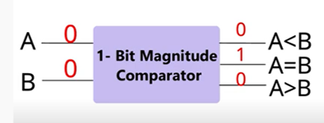
Summary
Basic System Functions
And, or, and not elements can be combined to form various logic functions. A few examples are:
The comparison function
A
A>B
B
A=B
A<B

Slide 6
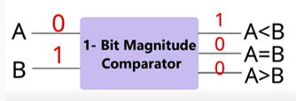
Summary
Basic System Functions
And, or, and not elements can be combined to form various logic functions. A few examples are:
The comparison function
A
A>B
B
A=B
A<B

Slide 7
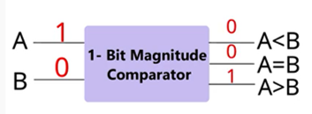
Summary
Basic System Functions
And, or, and not elements can be combined to form various logic functions. A few examples are:
The comparison function
A
A>B
B
A=B
A<B

Slide 8

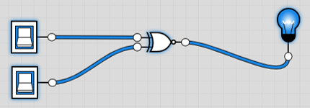
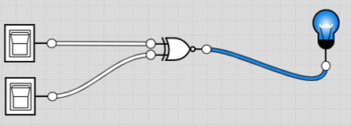
Summary
Basic System Functions
And, or, and not elements can be combined to form various logic functions. A few examples are:
The comparison function
X NOR Gate
X NOR Gate

Slide 9
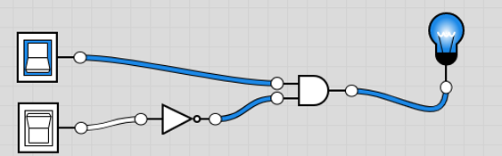
Summary
Basic System Functions
And, or, and not elements can be combined to form various logic functions. A few examples are:
The comparison function
AND and NOT Gate

Slide 10
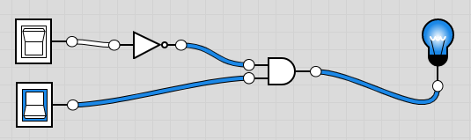
Summary
Basic System Functions
And, or, and not elements can be combined to form various logic functions. A few examples are:
The comparison function
AND and NOT Gate

Slide 11
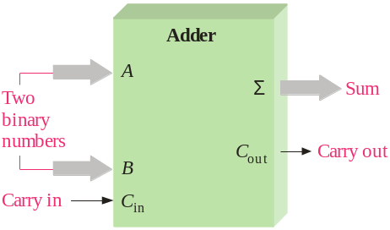
Summary
Basic System Functions
And, or, and not elements can be combined to form various logic functions. A few examples are:
Basic arithmetic functions

Slide 12
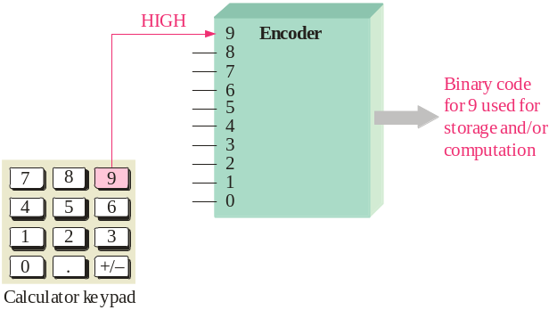
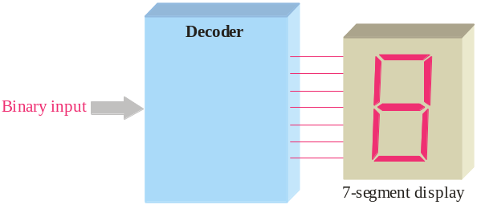
Summary
Basic System Functions
The encoding function
The decoding function

Slide 13
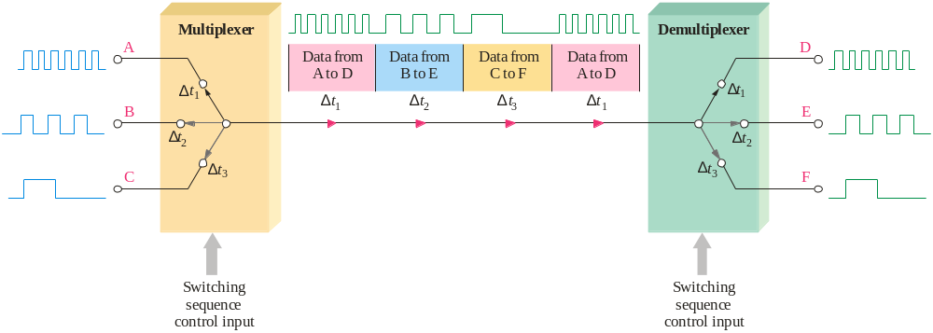
Summary
Basic System Functions
The data selection function

Slide 14

Summary
Basic System Functions
The counting function
Counter
Parallel output lines
Binary code for 1
Binary code for 2
Binary code for 3
Binary code for 4
Binary code for 5
1
2
3
4
5
Input pulses
Sequence of binary codes that represent the number of input pulses counted.
…and other functions such as code conversion and storage.

Slide 15
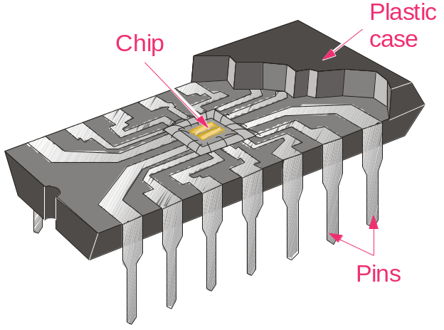
Summary
Integrated Circuits
Cutaway view of DIP (Dual-In-line Pins) chip:
The TTL series, available as DIPs are popular for laboratory experiments with logic.

Slide 16

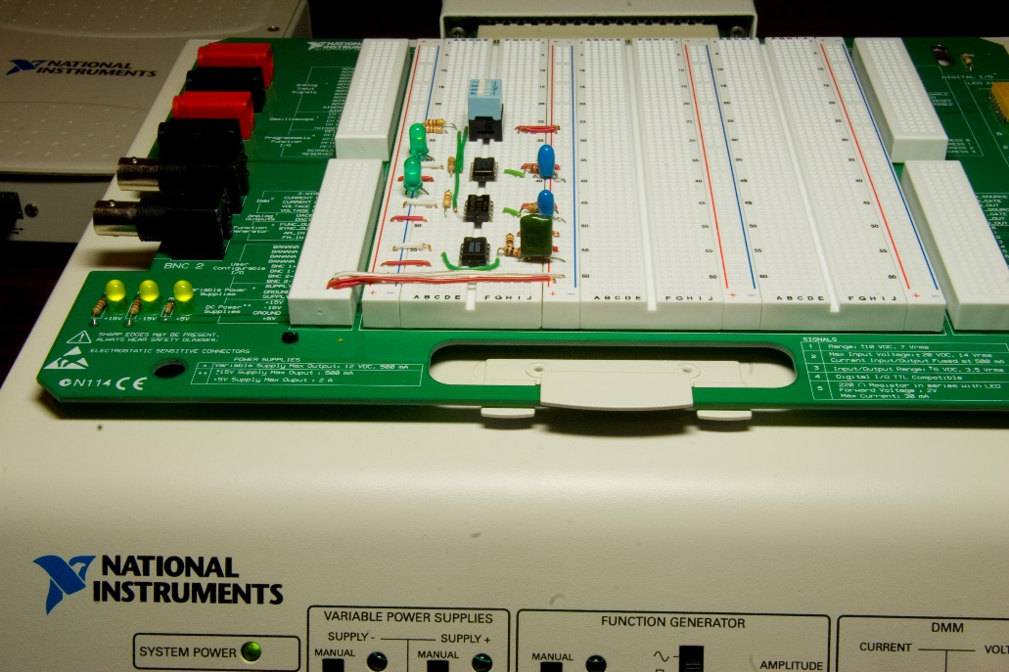
Summary
Integrated Circuits
An example of laboratory prototyping is shown. The circuit is wired using DIP chips and tested.
DIP chips
In this case, testing can be done by a computer connected to the system.

Slide 17
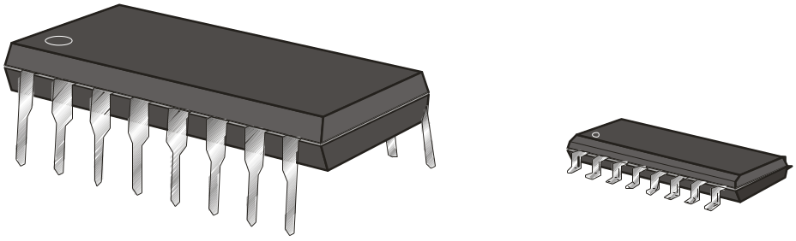
Summary
Integrated Circuits
DIP chips and surface mount chips
Pin 1
Dual in-line package Small outline IC (SOIC)

Slide 18
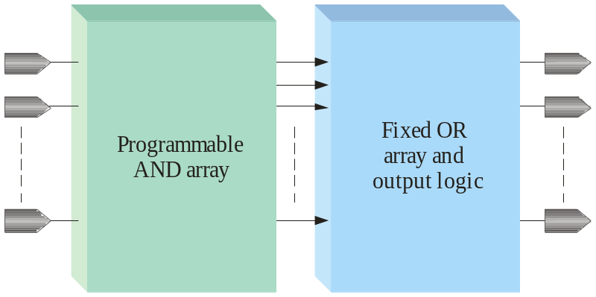
Summary
Programmable Logic
Programmable logic devices (PLDs) are an alternative to fixed function devices. The logic can be programmed for a specific purpose. In general, they cost less and use less board space that fixed function devices.
A PAL device is a form of PLD that uses a combination of a programmable AND array and a fixed OR array:

